Slide 2

Ephesians 6:1-4

Slide 3
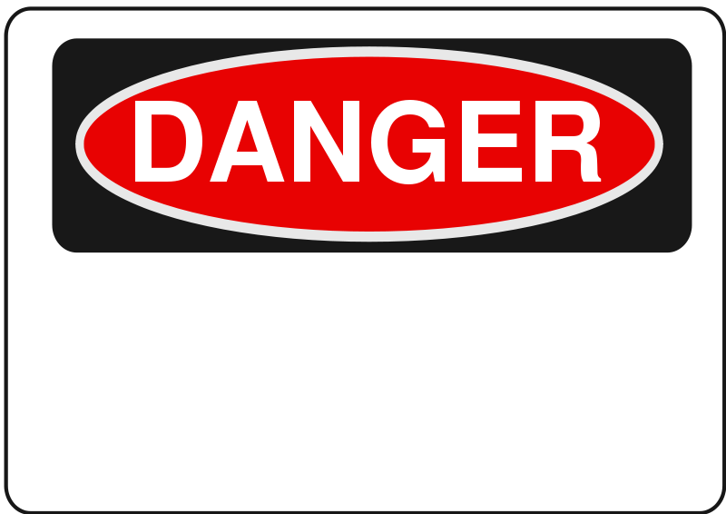
S
THAT NEED TO BE AVOIDED AS PARENTS!

Slide 4
SOME OF THE MISTAKES MADE BY PARENTS
NOAH’S DRUNKENNESS- Genesis 9:20-25
  Immediate cause of Ham’s disgrace
  Isaiah 5:11
  Proverbs 23:29-35
  Galatians 5:21
  Parents who drink, lose the respect of their children – and often cause the children to also become drunkards

Slide 5
SOME OF THE MISTAKES MADE BY PARENTS
LOT’S MATERIALISM- GENESIS 13:7-11
  Lot chose for himself all the plain of Jordan
  Genesis 19:1-26
  Ephesians 6:4
  Parents are obligated to bring up their children in the nurture and admonition of the Lord!

Slide 6
SOME OF THE MISTAKES MADE BY PARENTS
JACOB’S PARTIALITY- Genesis 37:3,4
  Genesis 25:28
  His father had favored Esau, his mother him
  No wonder he was prone to this same error with Joseph
  Children learn what they SEE in EXAMPLES!

Slide 7
SOME OF THE MISTAKES MADE BY PARENTS
DAVID’S HUMORING OF ADONIJAH - 1 Kings 1:5,6
  Never learned the meaning of the word “NO”
  Proverbs 23:13
  Proverbs 22:15
  God says: Children are to be DISCIPLINED – not PAMPERED or HUMORED!

Slide 8
SOME OF THE MISTAKES MADE BY PARENTS
ELI’S TOLERATION - 1 Samuel 2:22-25
  1 Samuel 3:13 “he did not restrain them.”
  He KNEW his sons were WICKED but did not take the proper action against them!
  Ecclesiastes 12:1- When they are YOUNG is the time to begin teaching them the FEAR OF THE LORD

Slide 9
ONE OF THE GREATEST DANGERS WE MUST AVOID AS PARENTS IS NOT BEING FAITHFUL CHRISTIANS AND SETTING THE PROPER EXAMPLES FOR OUR CHILDREN!

